Slide 1
SSVEP classification for the development of a BCI
A project for the course “Biomedical signal processing” (A.A. 2022/2023)
Filippo Uslenghi - 08307A
Notes:
BCIs are systems that determines the functional intent directly from the brain activity.

Slide 2
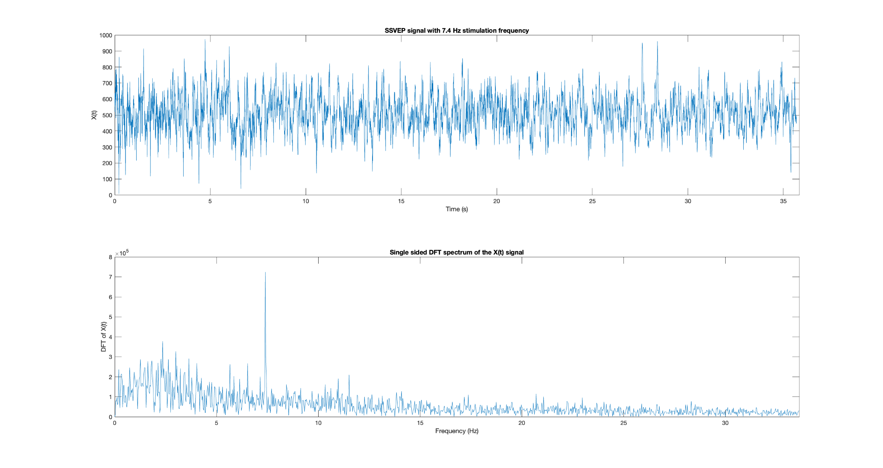
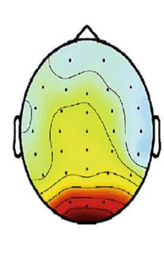
What are SSVEPs and why do they matter?
Steady state visually evoked potential
Electric signals originating in the occipital lobe
Visual stimuli blinking at specific frequencies
Same frequency (or multiples of) present in brain activity
BCI based on SSVEP signals collected using EEG
Notes:
Steady state visually evoked potentials (SSVEP) are signals that are natural responses to visual stimulation at specific frequencies. When the retina is excited by a visual stimulus ranging from 3.5 Hz to 75 Hz, the brain generates electrical activity at the same (or multiples of) frequency of the visual stimulus.
BCI is a system that determines the functional intent directly from the brain activity.
SSVEP-based BCI uses EEG signal to capture brain activity. To allow the user to make a choice on a task, the system will produce different visual stimuli, one for every option available. The user will need to look at the visual stimulus of his choice and the BCI will automatically know which pattern the user was looking at, thus executing his choice.

Slide 3
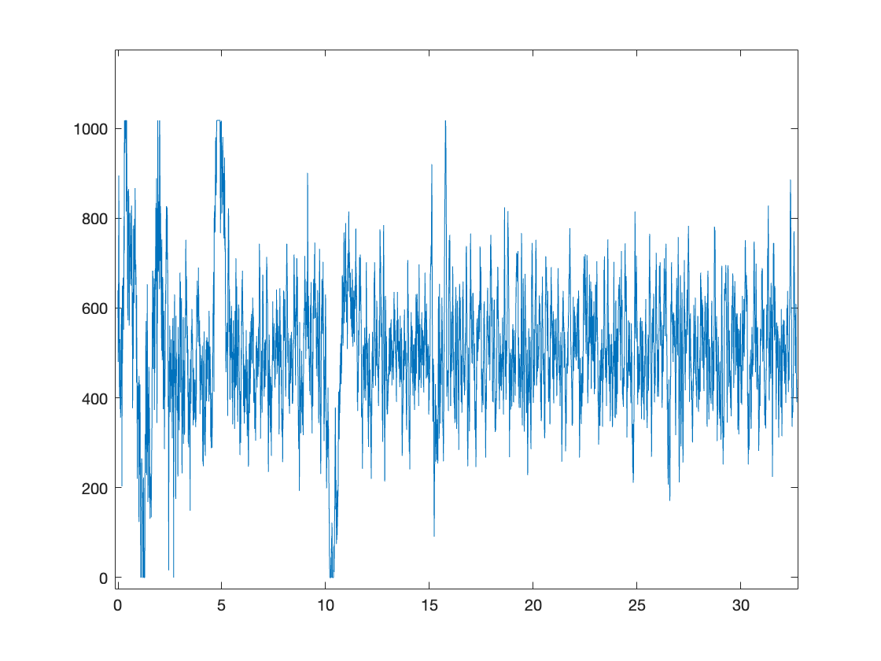
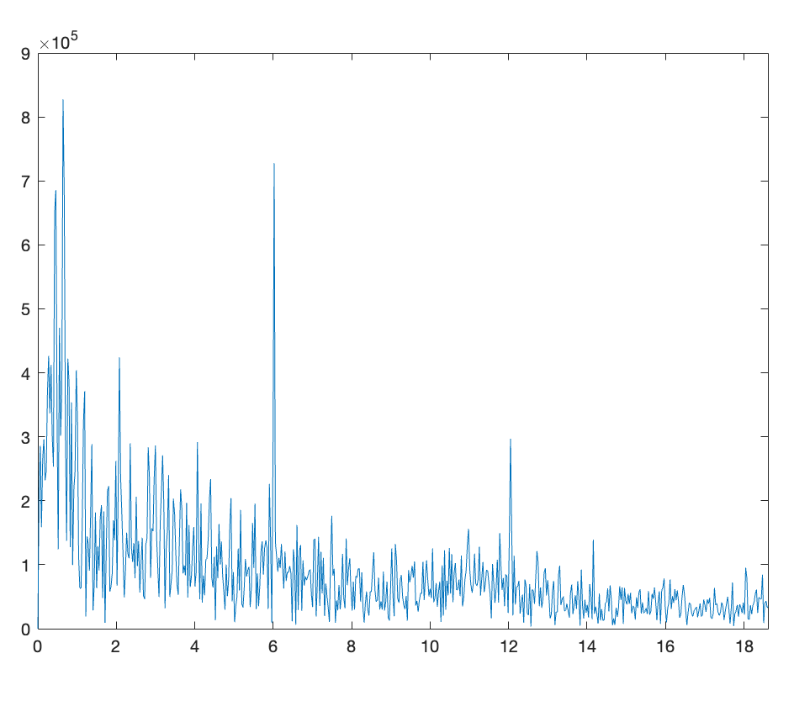
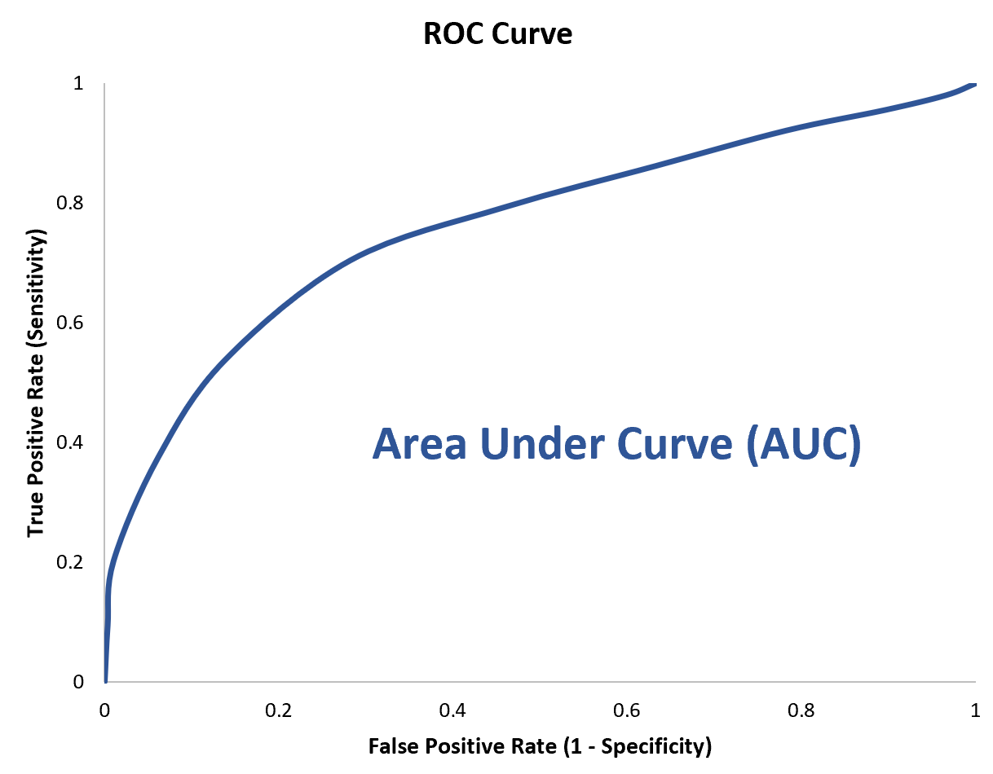
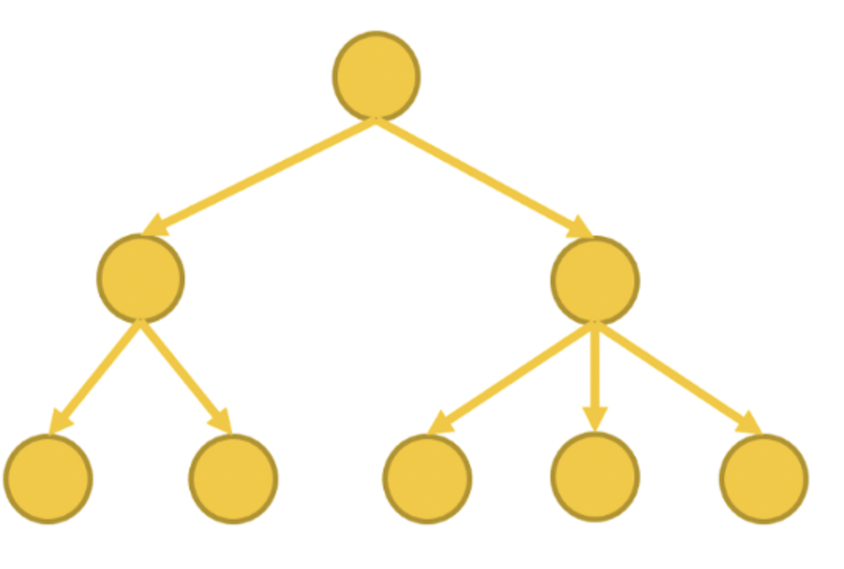
Methodology
Data collection
Feature extraction
Parameter optimization
Classification with decision tree

Slide 4
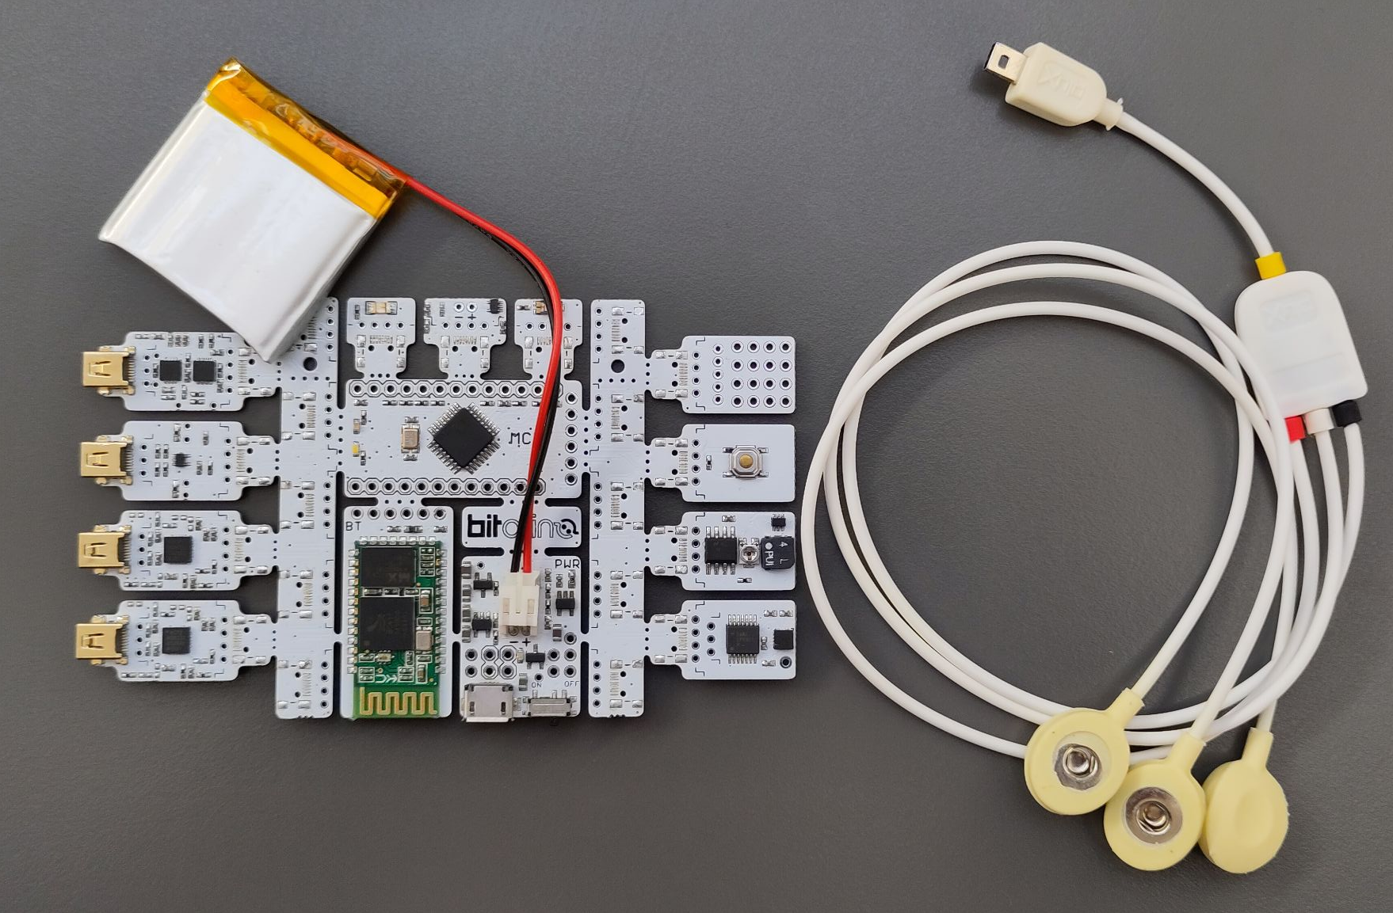
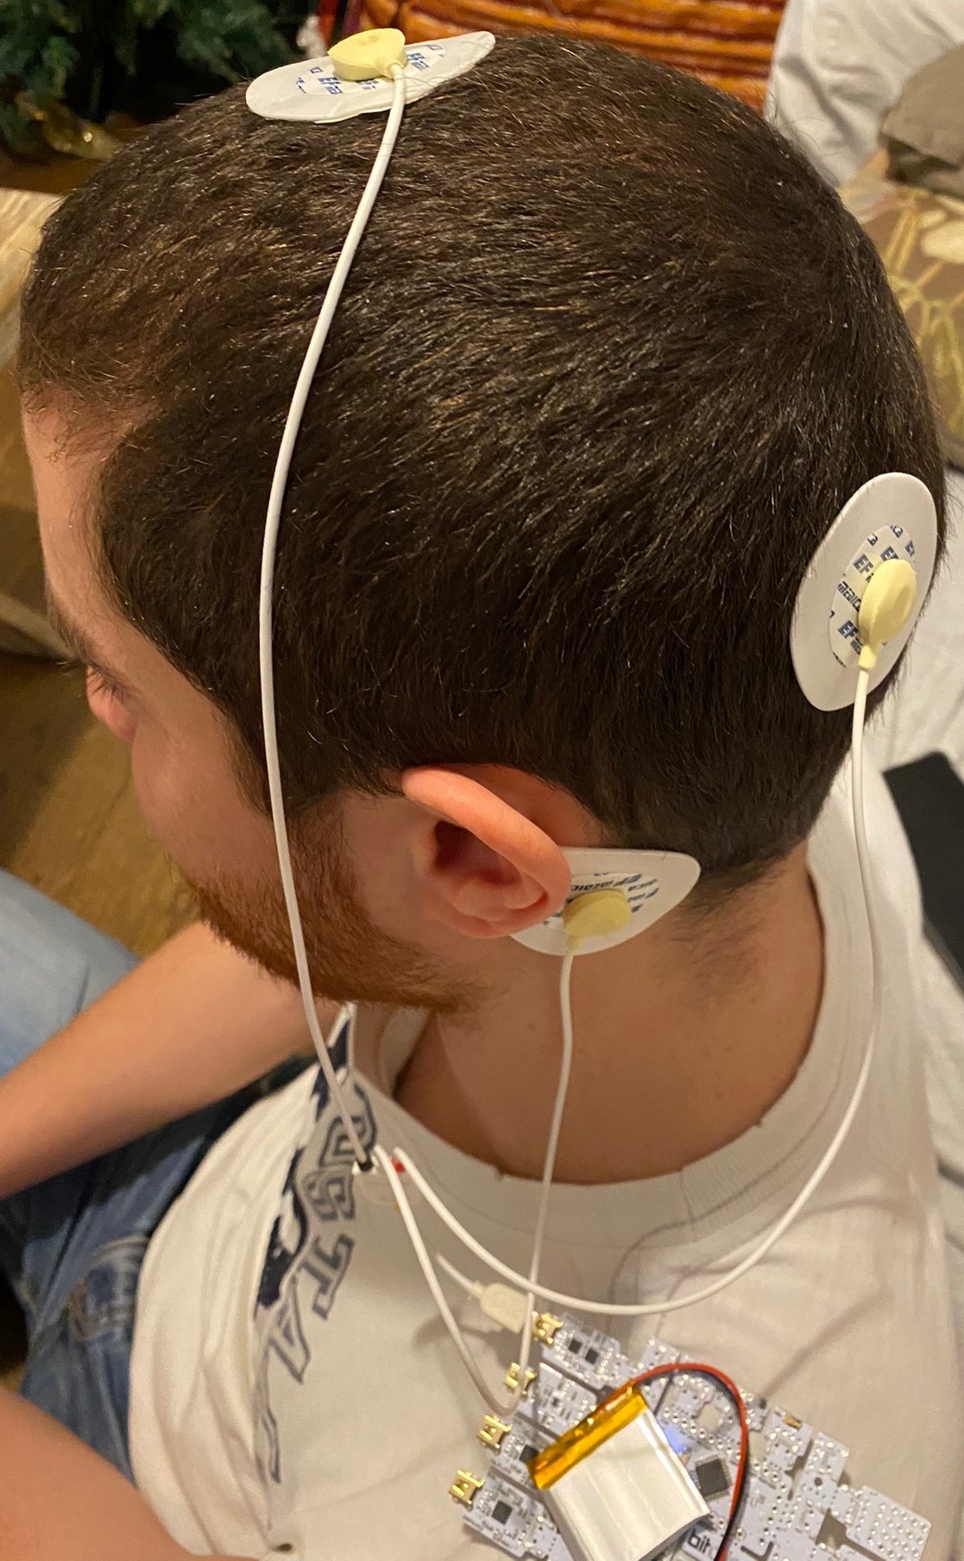
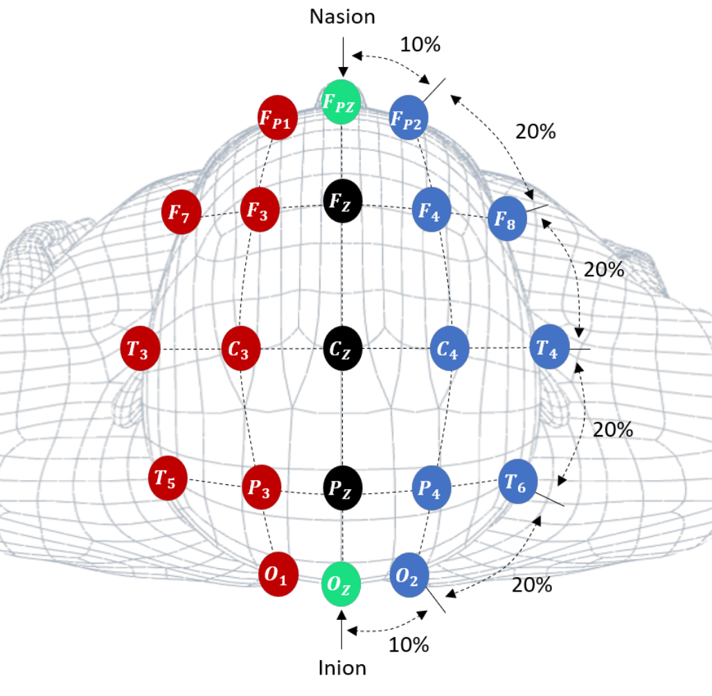
Data collection
BITalino (r)evolution Board
Bipolar, single channel EEG
International 10-20 system
(+) O1, (-) Cz, (⏚) mastoid
15 recordings of ~30 seconds
Light blinking at 6 Hz and 7.4 Hz, plus no stimulus at all

Slide 5
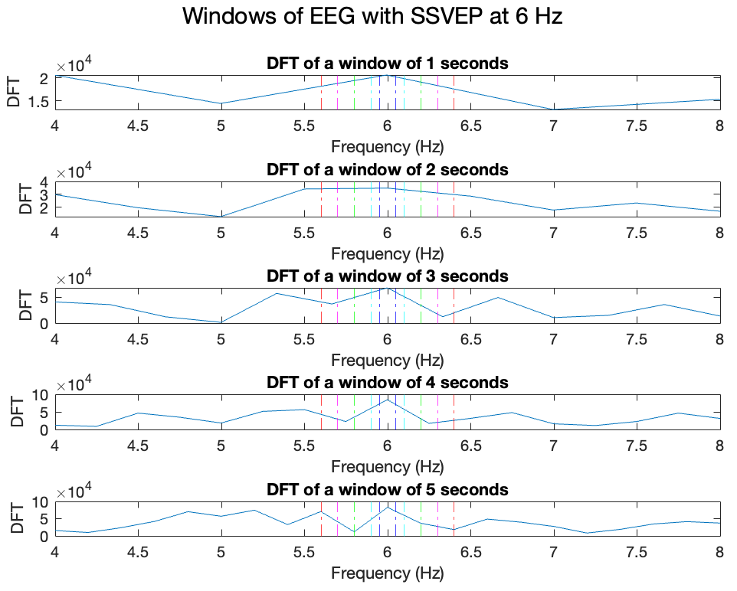
Feature extraction
Maximum value of DFT around the frequencies of interest
6 Hz and 7.4 Hz
Parameters considered:
Frequency range
0.05/0.1/0.2/0.3/0.4 Hz
Window length
1/2/3/4/5 seconds
[X,Y] for every configuration of parameters

Slide 6
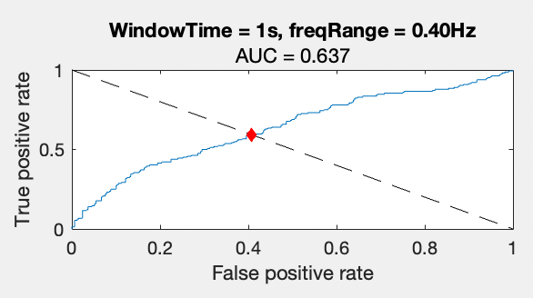
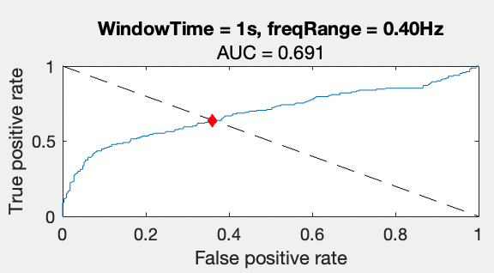
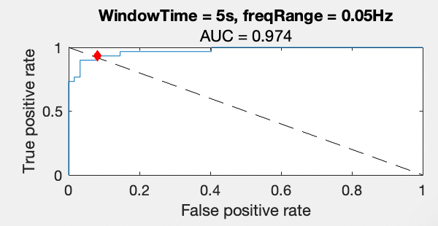
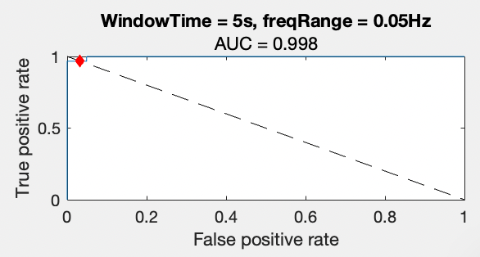
Setting the threshold
6 Hz
7.4 Hz
ROC curve
For each combination of window length and frequency range
One vs All
6 Hz vs all
7.4 Hz vs all
Balanced Tpr:Fpr

Slide 7
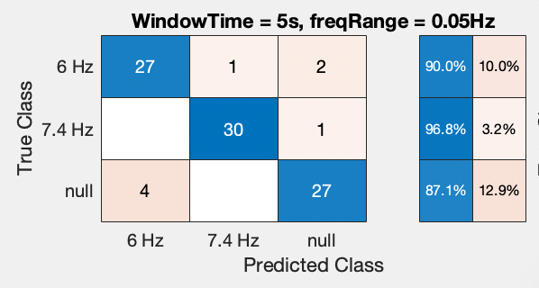
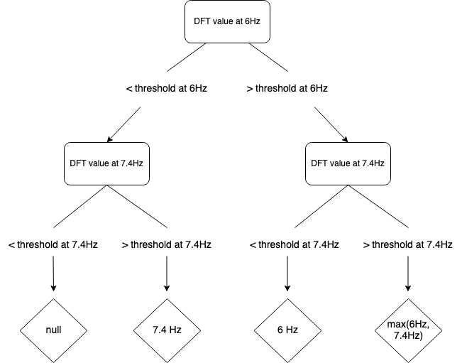
Classification
Thresholds of ROC curves as decision rules
3 classes
6 Hz, 7.4 Hz, null

Slide 8
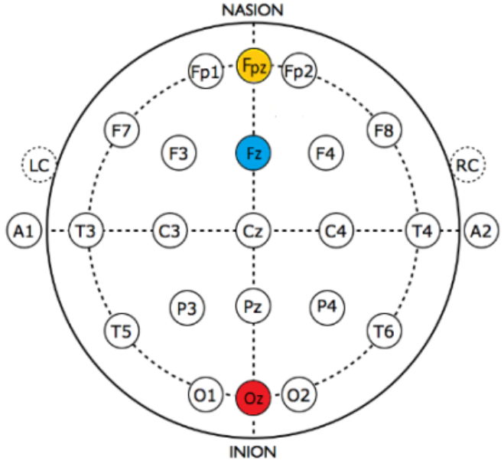
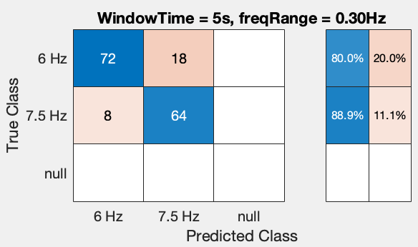
The AVI SSVEP dataset
Bipolar, single channel EEG
(+) Oz, (-) Fz, (⏚) Fpz
95 recordings (30 seconds) from 4 different subjects
15 with 6 Hz stimulus
12 with 7.5 Hz stimulus
absence of no-stimulus recordings
“A. Vilic (2014). AVI SSVEP Dataset [Online]. Available http://setzner.com/avi-ssvep-dataset"

Slide 9
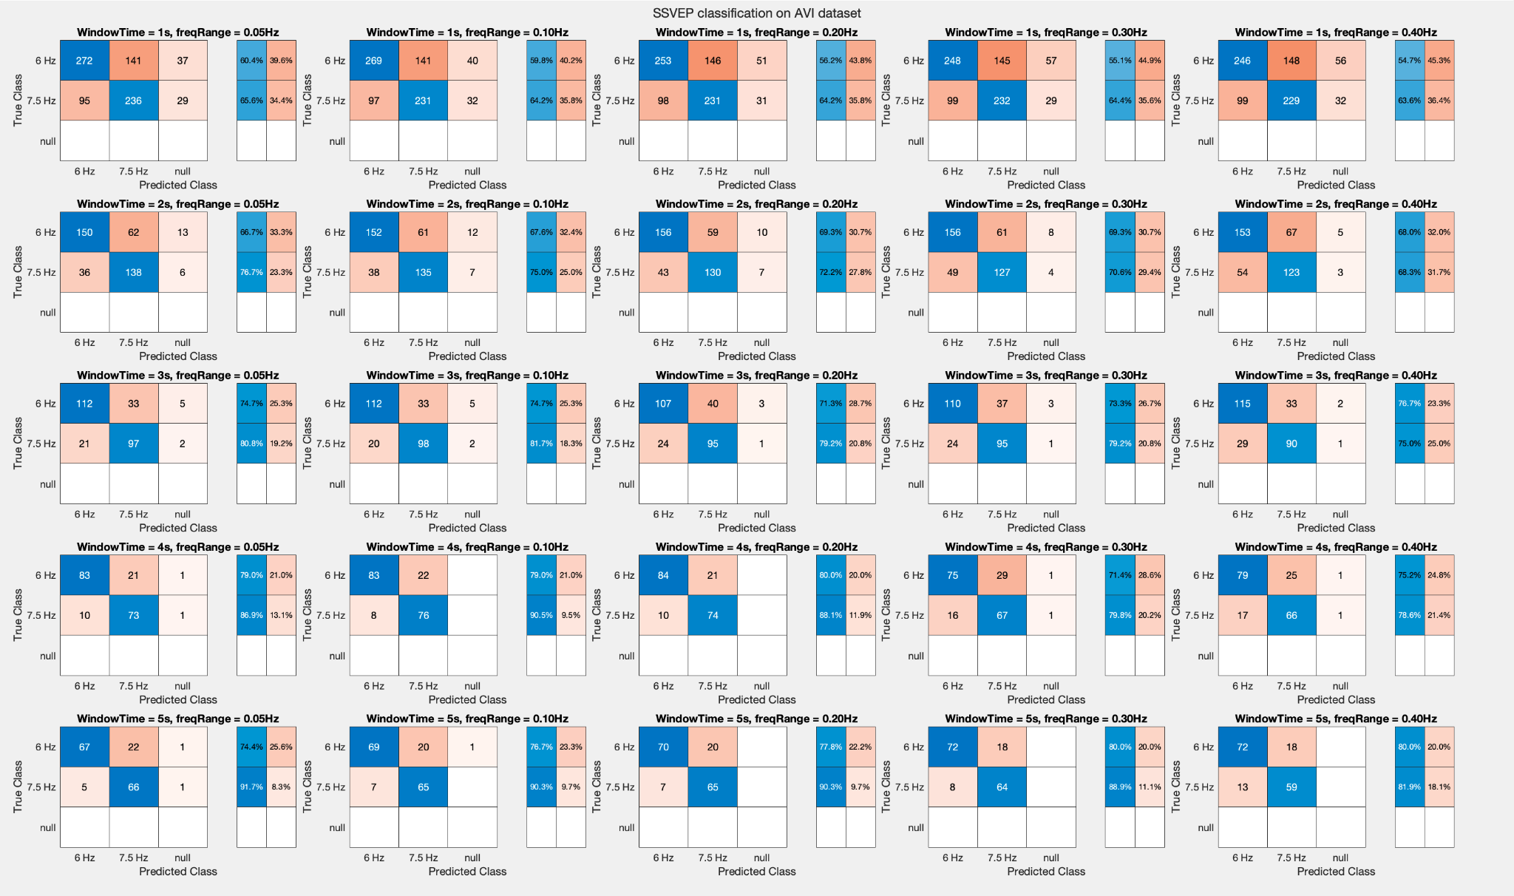

Slide 10
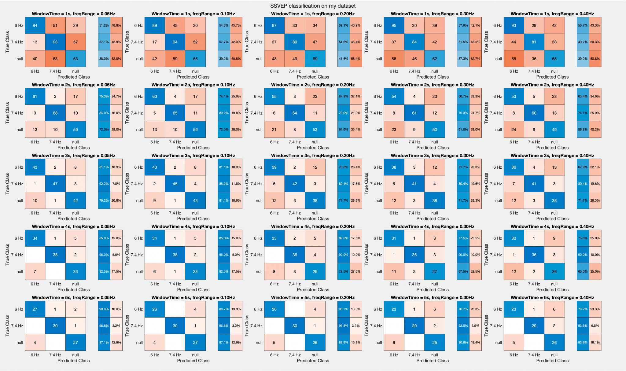

Slide 11
Thank you for your attention!

